Slide 1

G2M Case Study
Virtual Internship(LISUM28)
15-DEC-2023

Slide 2
Market Analysis for Cab Investment Firm
Objective:
Uncover valuable insights and trends in the transportation industry to guide informed decisions on market entry, expansion, or optimization for the Cab Investment firm.
Data Source:
Utilizing datasets from: DataGlacier/DataSets.
Analysis Steps:
Data Acquisition
Exploratory Data Analysis (EDA)
Market Trends Analysis
Customer Segmentation
Predictive Modeling (if applicable)
Recommendations & Insights

Slide 3
Data Exploration
Dataset Statistics:
Total Entries: 359,392
Data columns (total 16 columns)
Data Types:
int64: Transaction ID, Customer ID, Age, Income (USD/Month)
datetime64[ns]: Date of Travel
float64: KM Travelled, Price Charged, Cost of Trip
object: Company, City, Payment Mode, Gender, Population, Users, Date
Columns:
Transaction ID, Date of Travel, Company, City, KM Travelled, Price Charged, Cost of Trip, Customer ID, Payment_Mode, Gender, Age, Income (USD/Month), City, Population, Users, Date

Slide 4
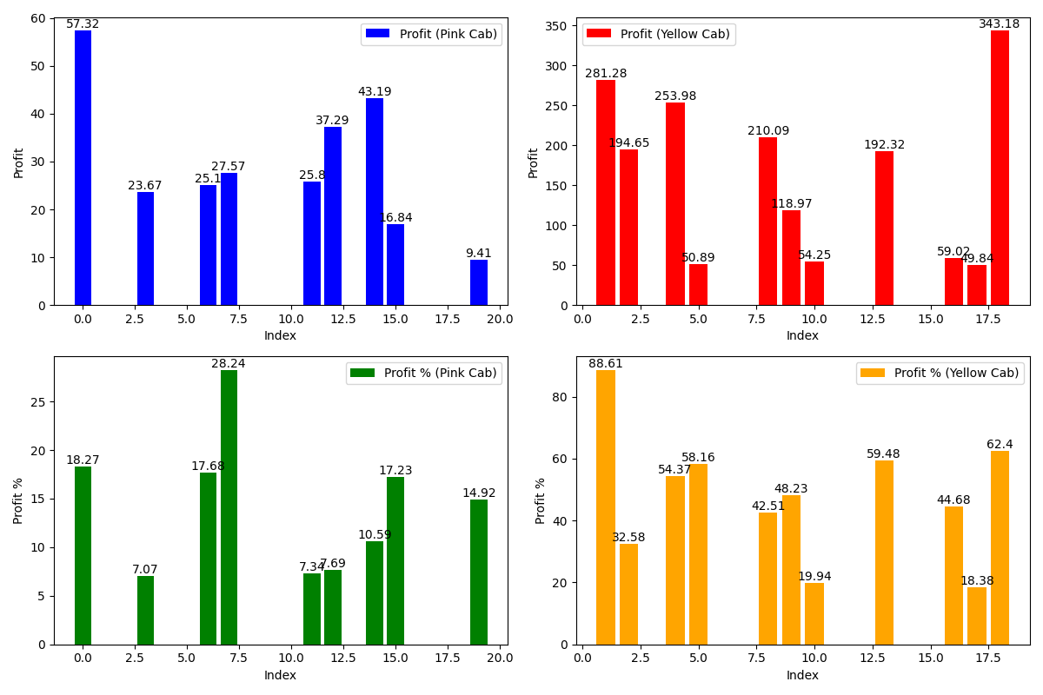
Profit and profit percentage

Slide 5
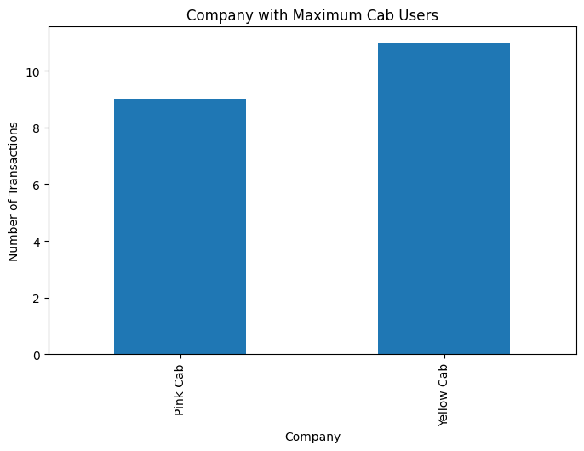
Company with Maximum Cab Users
Yellow company has maximum cab users

Slide 6
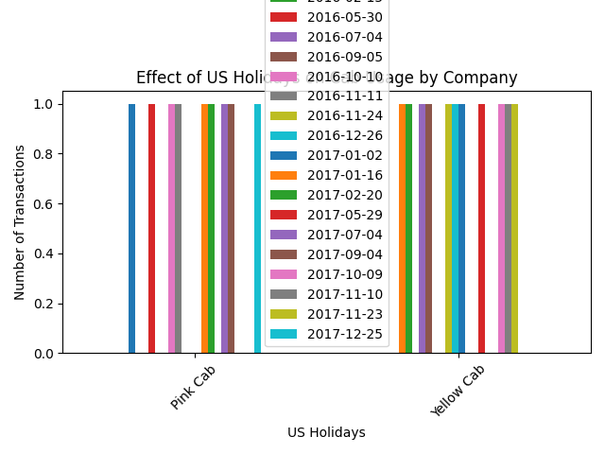
Effect of Holidays by Company

Slide 7
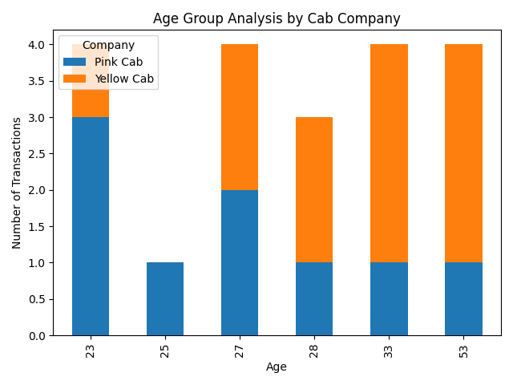
Age Group Analysis

Slide 8
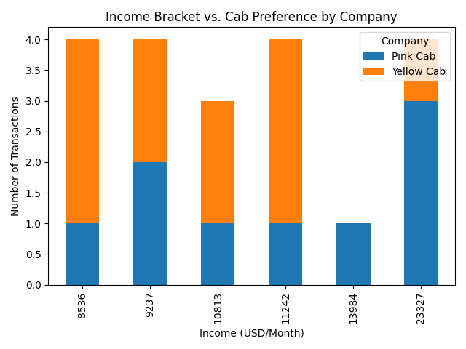
Income Bracket and Cab Preference

Slide 9
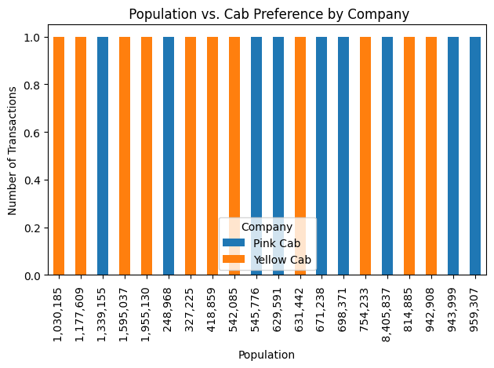
City Population vs. Cab Preference

Slide 10
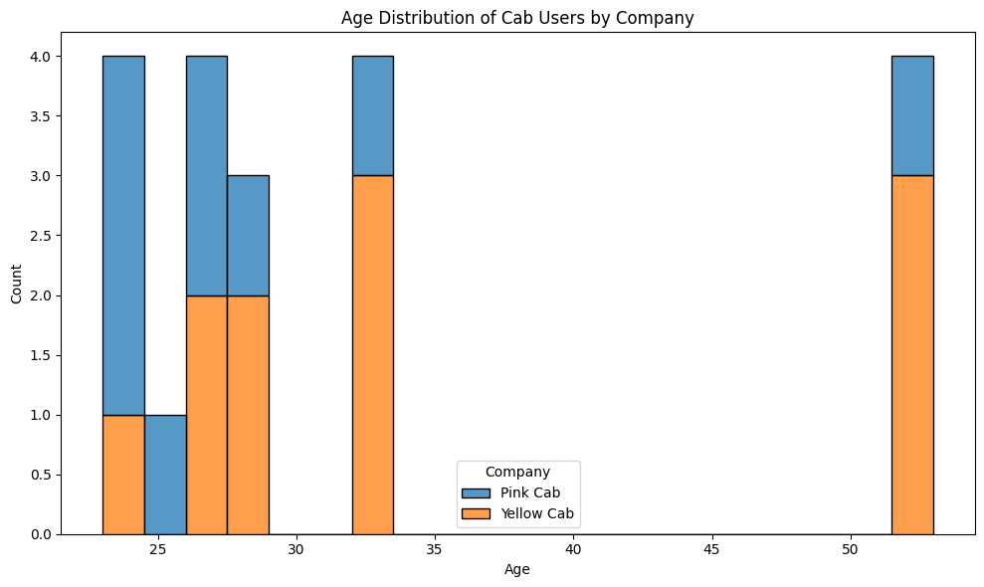
Age Distribution of Cab Users by Company

Slide 11
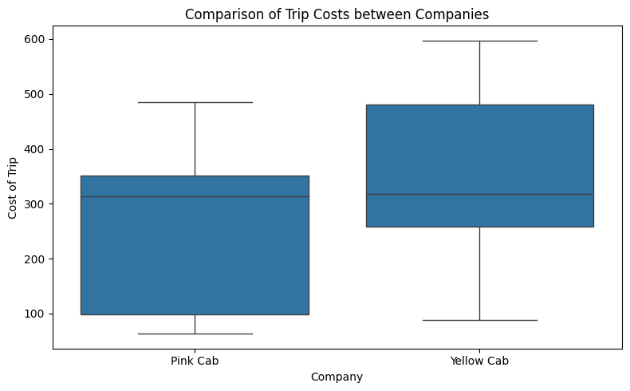
Comparison of Trip Costs between Companies

Slide 12
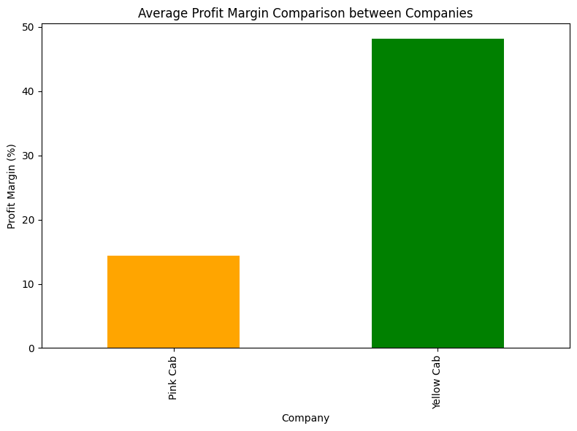
Calculate profit and profit margin

Slide 13
Recommendation for Investment in Cab Services
Profitability:
Higher Profit Margin:
Yellow Cab consistently demonstrates higher profitability compared to Pink Cab, as indicated by the analysis of profit margins and total profit.
Steady Profit Growth:
Over time, Yellow Cab has shown a consistent increase in profits, showcasing its reliability and potential for sustained growth.
Customer Base:
Larger Customer Base:
Yellow Cab has a significantly larger customer base compared to Pink Cab, highlighting a greater market presence and potential for expansion.
Stronger Customer Retention:
The retention analysis indicates that Yellow Cab has better customer retention rates, implying stronger customer loyalty and satisfaction.

Slide 14
Investment Consideration
customer base, investing in Yellow Cab appears to be a more promising venture. However, a comprehensive market study and risk assessment should accompany this recommendation for a well-informed investment decision.

Slide 15
Thank You

